Slide 1
Software Engineering Methodology
(BCSC0057)
Topic: Use Case Diagram
Lecture No.
Ruchi Agrawal
Assistant Professor, CEA deptt.
GLA UNIVERSITY Mathura, Uttar Pradesh, India

Slide 2
Requirement Engineering
Problem Statement
Requirements describe
What not How
Requirements Elicitation
Requirements Analysis
Requirement Engineering
Requirements Documentation
Requirements Review
SRS
Crucial Process Steps of requirement engineering

Slide 3
Requirements Elicitation
1. Interviews
2. Brainstorming Sessions
3. Facilitated Application specification Techniques (FAST)
4. Quality Function Deployment
5. The Use Case Approach

Slide 4
Use Case Diagram
Use Case – give functional view
Use case diagrams are graphical representations, captures who (actor) does what (interaction) with the system, without dealing with system internals.
Depict the behavior of the system, as it appears to an outside user.
Describe the functionality and users (actors) of the system.
Show the relationships between the actors that use the system, the use cases (functionality) they use, and the relationship between different use cases.
Illustrate the developer’s understanding of the user’s requirements.

Slide 5

Components of use case diagram
Actor : Who interacts with the system
Use case : Functionality and services provided by the system
Relationship : Relation between actor and use cases
System boundary
System boundary
Use case
Actor
-- Actors appear outside the rectangle.
-- Rectangular box represent the System
--Use cases within rectangle providing functionality.
--Relationship association is a solid line between actor & use cases.
Use case
Actor
Use case

Slide 6
Use case diagram for Result Management System
Maintain Student Details
Maintain Subject Details
Data Entry Operator
Maintain Result Details
Login
Teacher
Administrator/DR
Generate Result Reports
View Results
Student

Slide 7
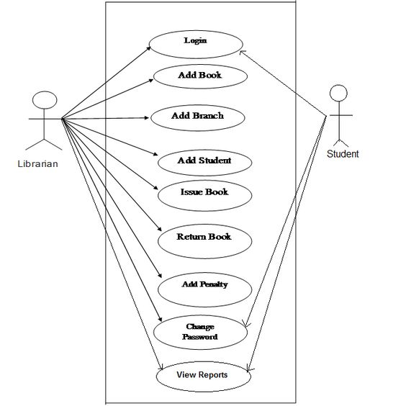
Use case diagram for Library Management System

Slide 8
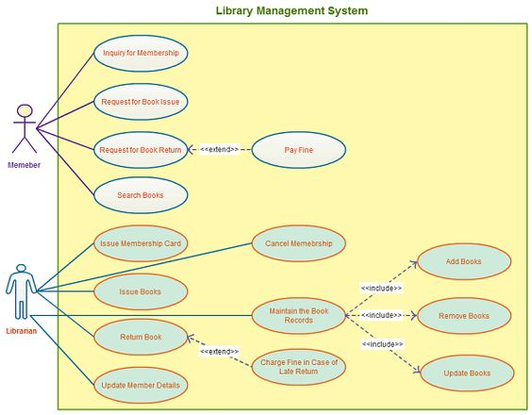

Slide 9
References
K.K. Aggarwal and Yogesh Singh, “Software Engineering”, Third Ed., New Age International (P) Limited Publishers. (2009).
Pankaj Jalote, “An Integrated Approach to Software Engineering”, Third Ed., Narose Publishing House, (2008).
Rajib Mall, “Fundamentals of Software Engineering”, Fourth Ed., PHI Learning Private Limited, (2016).
Roger S. Pressman, “Software Engineering: A Practitioner’s Approach”, Fifth Ed., McGraw–Hill Higher Education, (2001).

Slide 10
Thank You

